Slide 1

promise
Unit 12

Slide 2
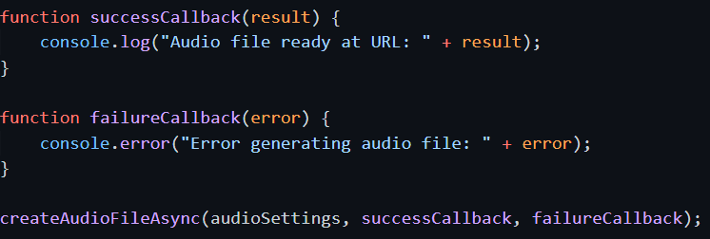
promise
The Promise object represents the eventual completion (or failure) of an asynchronous operation and its resulting value.
Basic usage:
Async with callbacks
Async with Promise

Slide 3
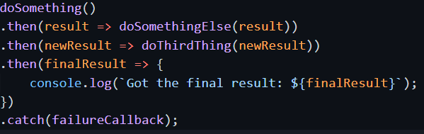
Advantage of using promise
Callbacks added with then() will never be invoked before the completion of the current run of the JavaScript event loop.
These callbacks will be invoked even if they were added after the success or failure of the asynchronous operation that the promise represents.
Multiple callbacks may be added by calling then() several times. They will be invoked one after another, in the order in which they were inserted.

Slide 4
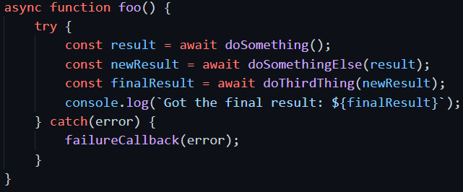
Await a promise
The async/await, with promise:
This syntax makes it looks like sync programming, easy to write and understand, but has the power of async efficiency when dealing with I/O.

Slide 5
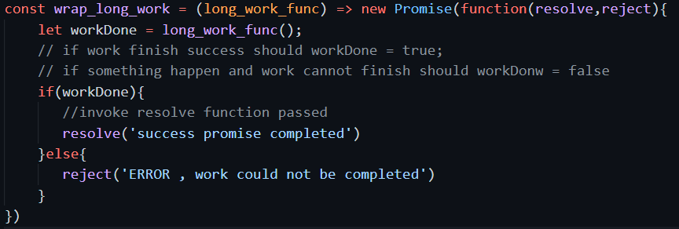
Create promise wrap work need wait
For time consuming function which blocking, can wrap with promise to make it async.

Slide 6
Create promise to wait
Can wait for some time then start some processing.

Slide 7
composition
If we have many work, and we need wait for all of them to finish.
Promise.all will arrange all work in parallel.
Sequential arrange of work need some special programming.

Slide 8
Composition 2 – race for first
Promise.race will arrange all work in parallel but wait for any one to finish.

Slide 9
Composition 3 – any for first fulfill
Promise.any will arrange all work in parallel but wait for any one which resolve first.
If all reject then finally reject.

